Slide 1
Python

Slide 2
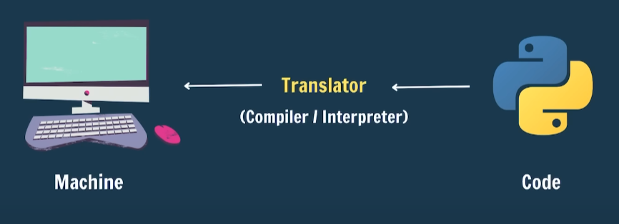
Programming

Slide 3
What Is Python?
Python Is Simple & easy .
Cross-platform
Developed by Guido van Rossum 1991.
Free & open source.
High level language.

Slide 4
🧠 What Can We Make with Python?
Field | Tool/Library | Example
Web Dev | Django, Flask | Blog, Online Store
Data Science | Pandas, NumPy | Sales Reports
AI / ML | TensorFlow, PyTorch | Face Detection
Automation | os, Selenium | Auto Email Sender
Games | Pygame | Snake Game
GUI Apps | Tkinter | To-Do App
Web Scraping | BeautifulSoup | News Headlines
IoT | RPi.GPIO | Smart Home System

Slide 5
First Program
print("Hello, world!")

Slide 6
Python Installation

Slide 7
Visual studio Code installation

Slide 8
Best extensions for Python in vs code
Code runner
Python
Pylance
Jupyter
Python Docstring Generator
Isort
Black Formatter

Slide 9
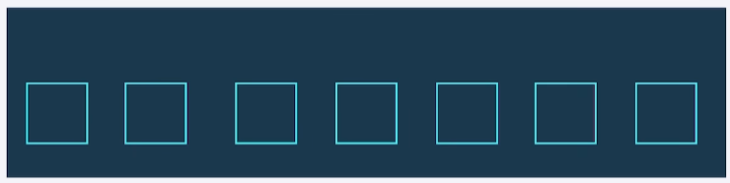
Variables
A variable is a name given to the memory location in a program .
    Ex
      Name = “AmazonTech”
      Name =“hello”
      Course = “python”
      Language = “Pashto”
      Price =3000

Slide 10
Comments in python
#Single-line Comment
'''
This is a multi-line comment.
It spans multiple lines.
'''

Slide 11
Rules for Identifiers
Any name you define in Python code is an identifier.
Rule # | Description | Example
1️⃣ | Must start with a letter (A–Z, a–z) or an underscore (_) | ✅ age, _name❌ 1age
2️⃣ | Can include letters, digits, and underscores | ✅ student_1, mark2
3️⃣ | Cannot start with a digit | ❌ 2name
4️⃣ | Case-sensitive (uppercase ≠ lowercase) | name ≠ Name
5️⃣ | Cannot be a Python keyword And special symbols. | ❌ if, while, for, class, def, etc. ❌ !,#,$,%,&

Slide 12
Data Types
Data Type | Description | Example
int | Integer numbers | 5, -20, 1000,0
float | Decimal numbers | 3.14, -1.5, 0.0
Str | Text (string) | "Hello", 'Python’ , '''name'''
bool | Boolean (True/False) | True, False
list | Ordered, changeable collection | [1, 2, 3], ["apple", "banana"]
tuple | Ordered, unchangeable collection | (10, 20), ("a", "b")
dict | Key-value pairs | {"name": "Ali", "age": 27}
set | Unordered, unique elements | {1, 2, 3}
Notes:
# fruits = ["apple", "banana", "cherry"]
# fruits[0] = "mango" # You can change elements
# fruits[1] = "orange"
# print(fruits)
# tuple_fruit# tuple_fruits = ("apple", "banana", "cherry")
s[0] = "mango" # This will raise an error
# print(tuple_fruits)
# set_fruits = {"apple", "banana", "cherry"}
# set_fruits.add("mango")
# print(set_fruits)

Slide 13
Keyword's
import keyword
print(keyword.kwlist)
      False, True, None, and, or, not, if, else, while, for, break, def, return, class, try, except, pass, import, from…
      Sum or input Example

Slide 14
Types of Operators
An operator is a symbol or word that performs an operation on values or variables.
Type | Description | Example
1️⃣ Arithmetic | Math operations | +, -, *, /, %, **, //
2️⃣ Assignment | Assign values | =, +=, -=, *=, /=, %=,**=
3️⃣ Comparison (Relational) | Compare values | ==, !=, >, <, >=, <=
4️⃣ Logical | Combine conditions | and, or, not
Notes:
5️⃣ Identity is, is not
a is b # True if a and b are the same object
a is not b # True if a and b are different
6️⃣ Membership in, not in
fruits = ["apple", "banana"]
"apple" in fruits # True
"mango" not in fruits # True
7️⃣ Bitwise(Binary operations ) & , `
a & b # AND
a | b # OR
a ^ b # XOR
~a # NOT
a << 2 # Shift left
a >> 2 # Shift right

Slide 15
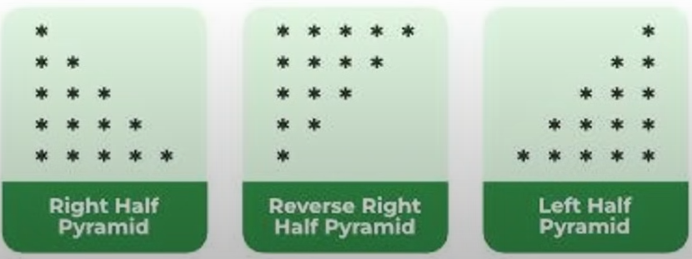
Challenges
Task:
Create a Python program that:
Declares variables for:
  Your name (str )
  Age (int)
  Height in meters (float)
  Is_student (bool)
Print each variable using print()
Add meaningful comments to each line
2. Draw the patterns

Slide 16
Practice Exercise
Answer in True (T) / Fals (F):
    Python is a compiled language and does not use an interpreter.
    A variable in Python must be declared with a data type like int or str.
    Comments in Python start with double slashes //
    The print function is used to display output in Python
    Strings in Python are surrounded by either single ‘ or double “ quotes.
    The + operator can be used to join two strings
    The True and False are valid Boolean values in Python.
    Python supports object-oriented programming.
    Python is case-sensitive, meaning Name and name are different

Slide 17
?

